Slide 1
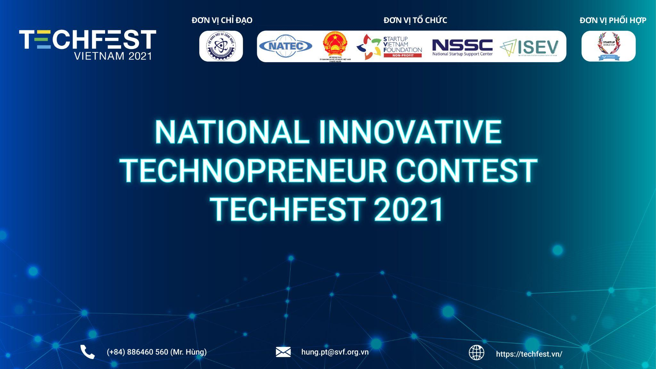



Slide 2



1. NAME OF THE PROJECT
THE MATRIX
2. COMPETITION TRACKS
Tech - Finance Startup

Slide 3
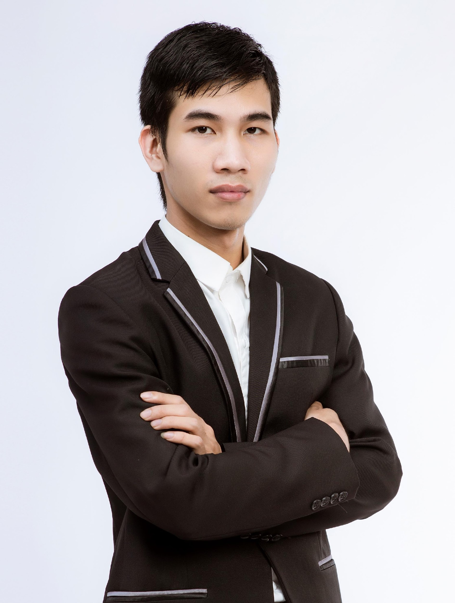

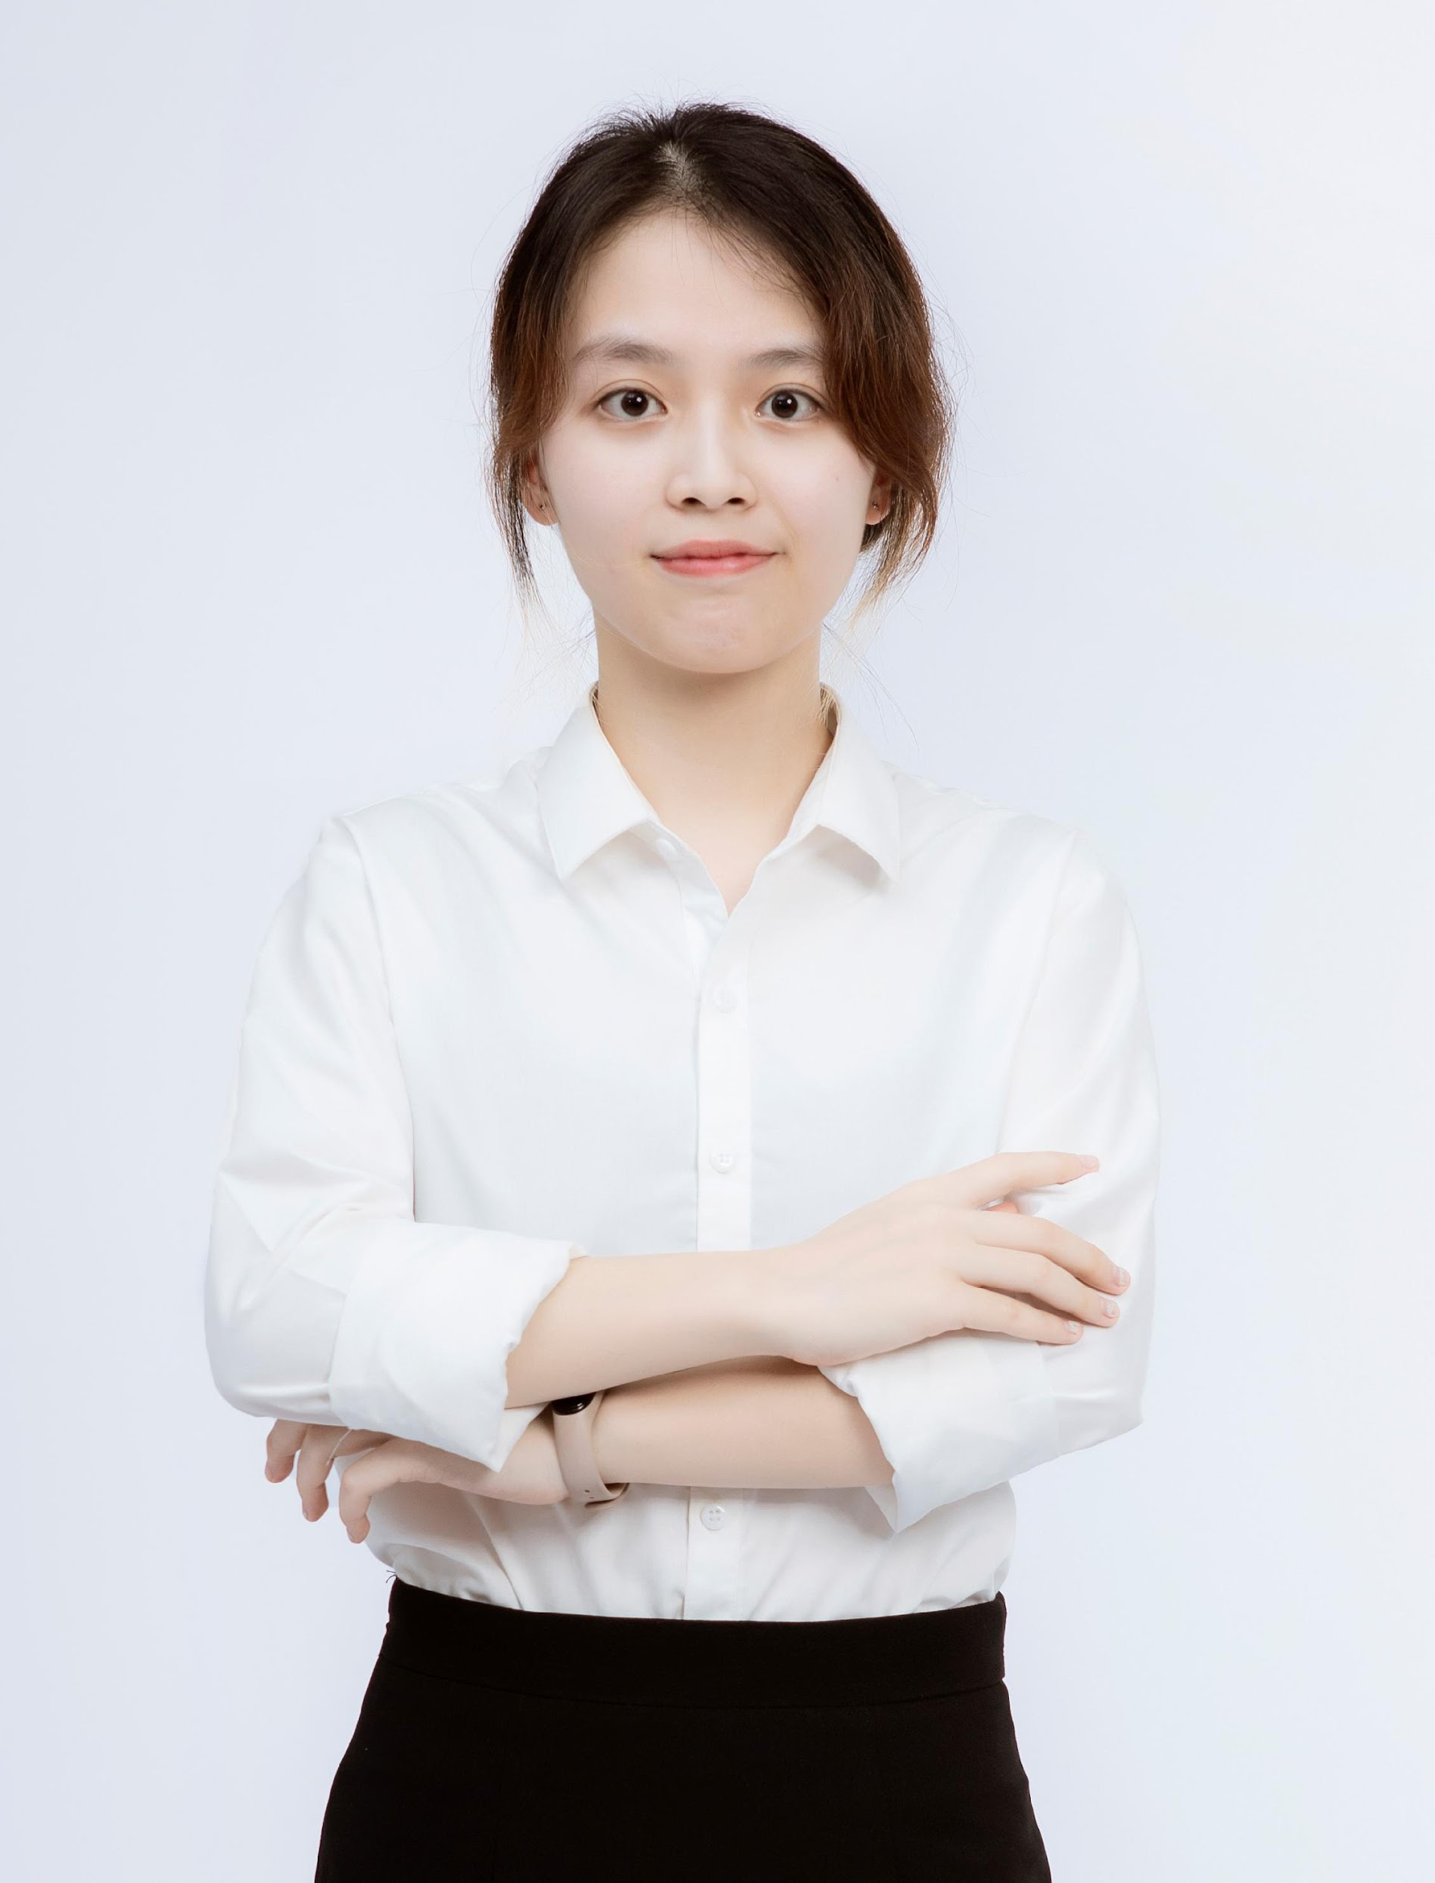

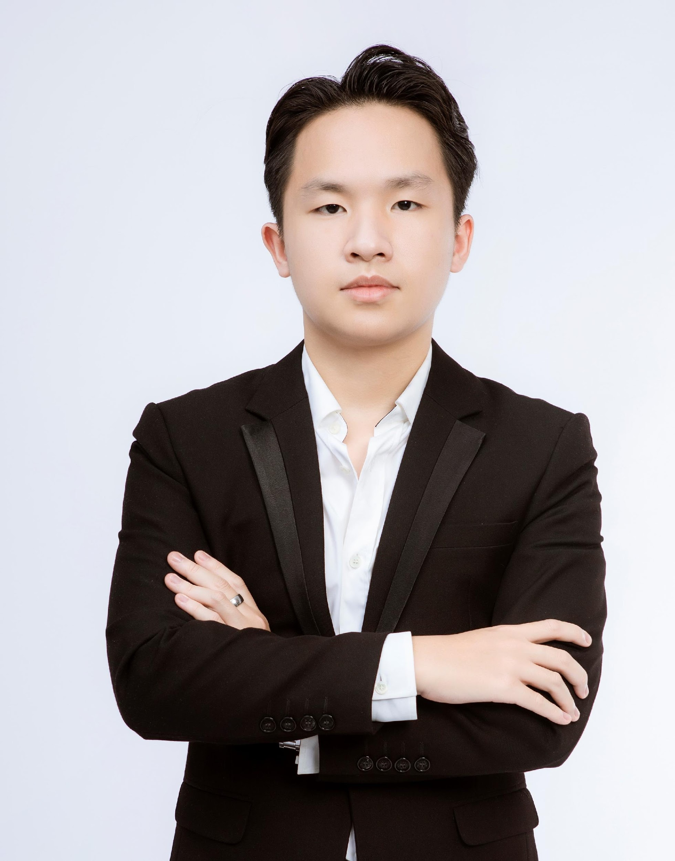
3. CORE TEAM MEMBERS
Nguyen The Thanh Dat IT student @ Thuy Loi University
2-year experience Programme Dev
Pham Huy Hung (leader) IT student @ Thuy Loi University
3-year experience App & Website Dev
SmartHome Project
Covid Prevention App
Tran Thao Van IT student @ Thuy Loi University
GPA: 3.82/4.0
In charge: IT, marketing
Le Thu Thuy BA student @ VNU, Hanoi
GPA: 3.2/4.0
4-year experience in Graphic Design
In charge: marketing and PR
Le Quang Truong BA student @ FTU
2-year experience in Sales

Slide 4


4. PROBLEMS & SOLUTIONS
4.1. PROBLEMS
🡺
1000 start-ups/ 1 year
80% - 90% of projects fail...

Slide 5

4. PROBLEMS & SOLUTIONS
4.1. PROBLEMS: start-up
Small scale
Difficult to access to contests/ investors
Feasible & breakthrough
ideas

Slide 6

4. PROBLEMS & SOLUTIONS
4.1. PROBLEMS: investor
Investors like operating projects
They are looking for idea banks to approach, move into new fields, invest in innovations…
Difficult in evaluating groundbreaking, high-potential, and risky ideas

Slide 7



Existing Solutions
4. PROBLEMS & SOLUTIONS
still
IN-EFFECTIVE!
Family and friends
Themselves
Banks
Start-up Incubators
Community Campaign
🡺

Slide 8

4. PROBLEMS & SOLUTIONS
4.2. SOLUTIONS
Capital Flow Guarantee
Secure
Platform
Commitment
Start-up & Investor
meet in 1 place
Transparent

Slide 9
5. PRODUCT / SERVICE
THE MATRIX
MEET THE INVEST

Slide 10


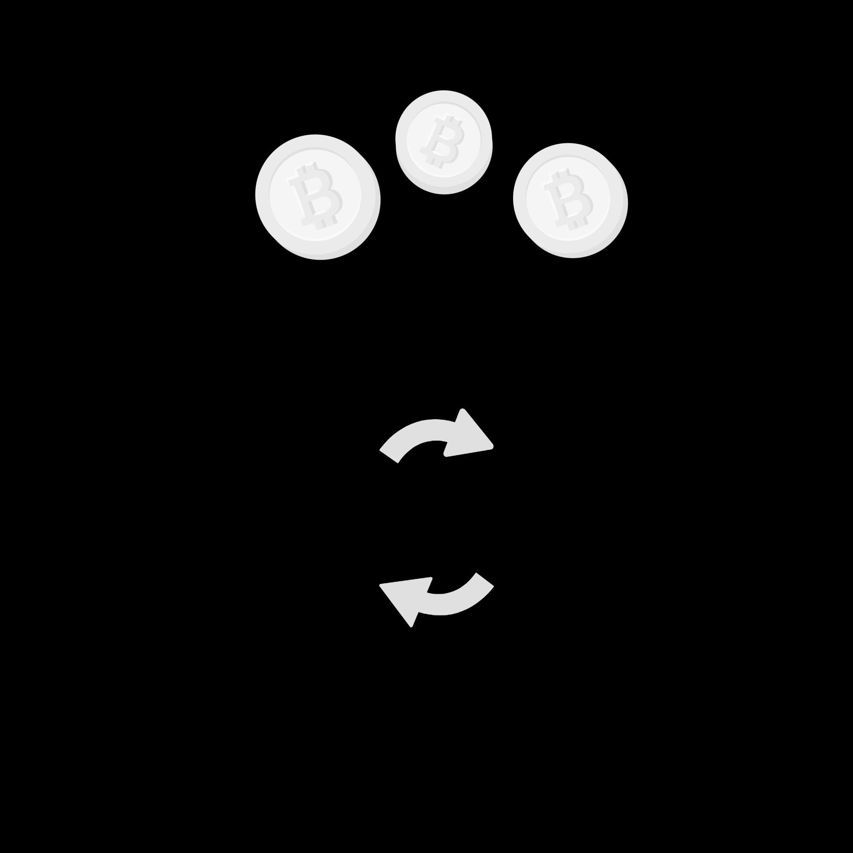
5. PRODUCT / SERVICE
OPERATION SYSTEM
Information
Benefits
Start-up
Investments
Connection
Investors

Slide 11
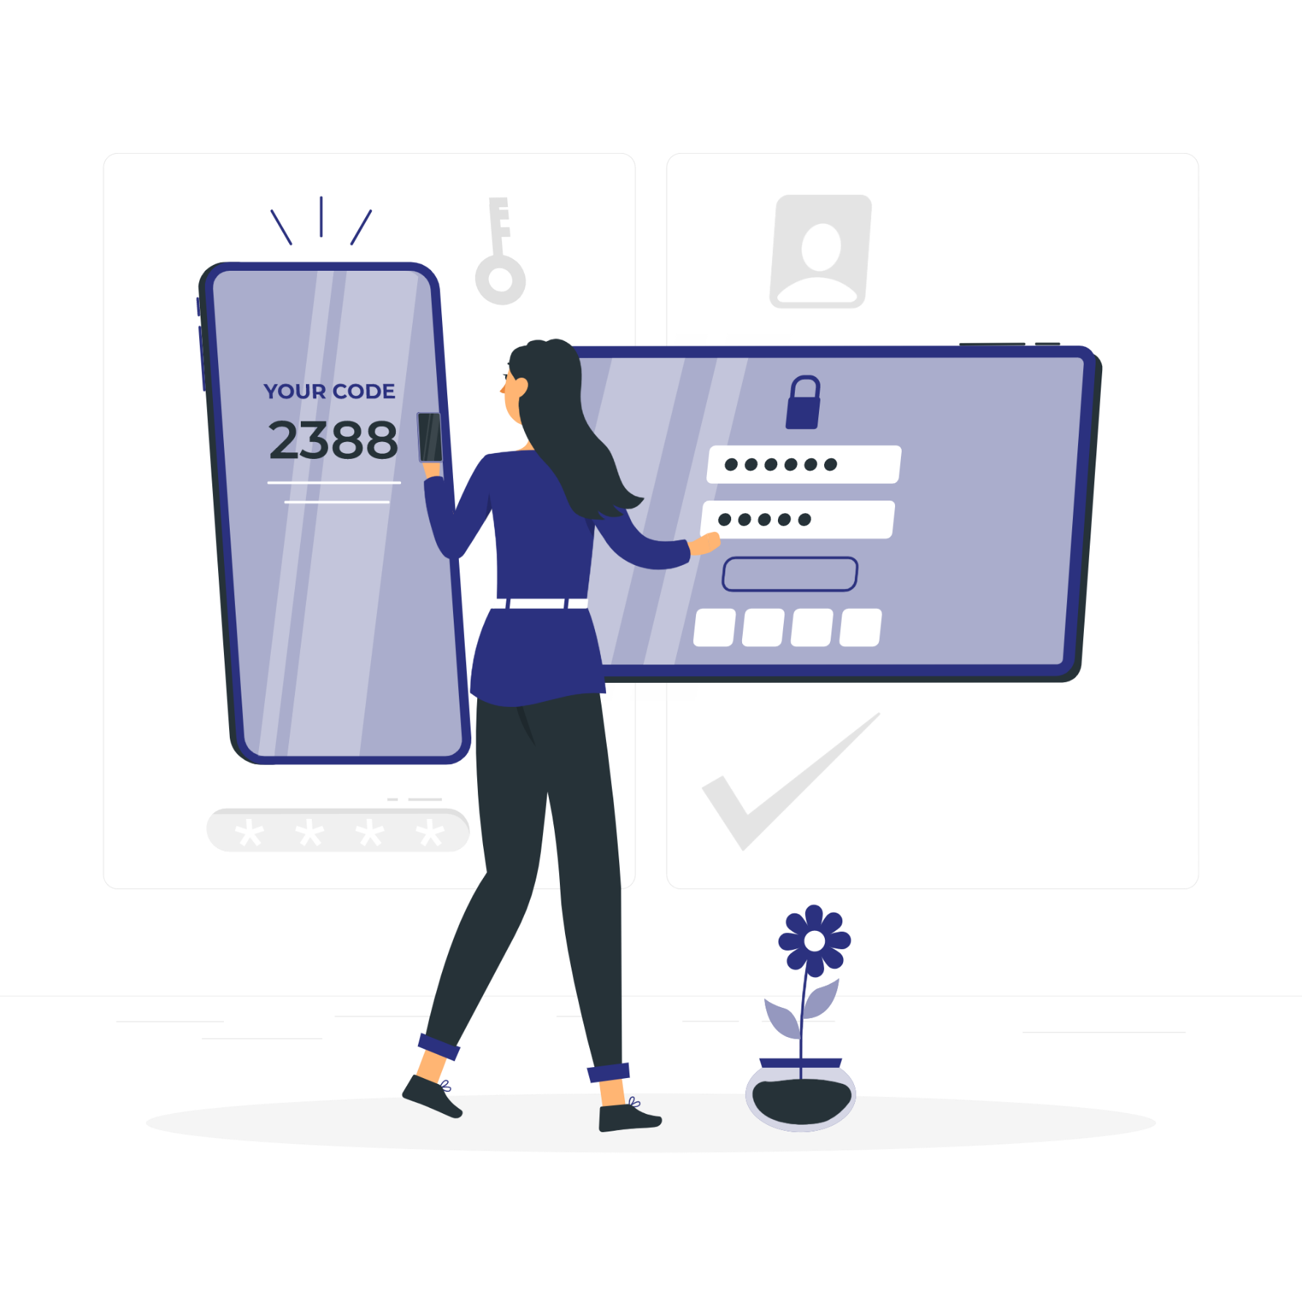
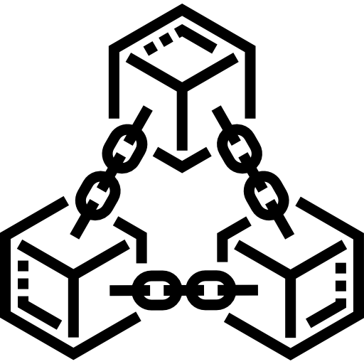
5. PRODUCT / SERVICE
iOS/Android applications
The Matrix is a system
Websites
Multi-platform
Blockchain-based technology

Slide 12
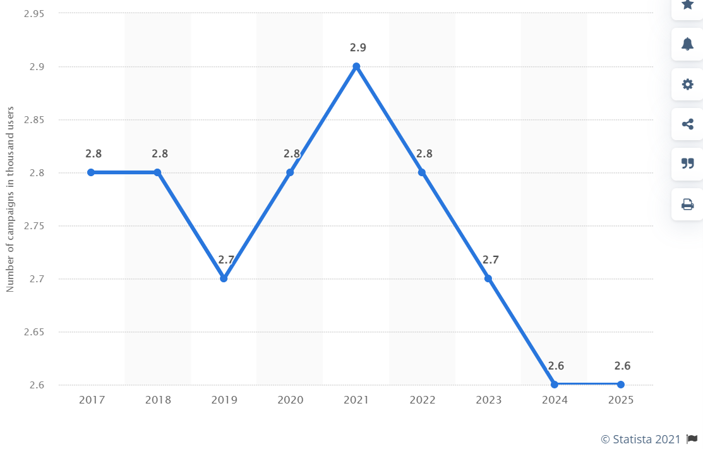
6. MARKET OVERVIEW AND COMPETITORS
Vietnam: number of crowdfunding campaigns 2017-2025

Slide 13


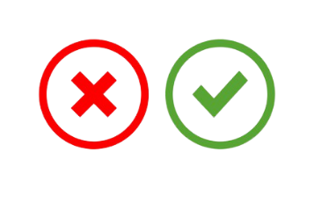
6. MARKET OVERVIEW AND COMPETITORS
Characteristics | The Matrix | BeeKrowd | B3SHARK
Blockchain platform
Feedback from startup, investor
Disbursement follow progress
Smart contract
Amount of investment capital | Small | Large | Large

Slide 14

7. TARGET CUSTOMER
Investors
Start-up
Projects

Slide 15

7. TARGET CUSTOMER
Stage 1 ( 12-24 months)
- Investors: flexible angel investors (≥ 500$)
- Mentors, experts…
- Start-up projects: individuals (ex: students...), groups start from the same idea, project at pre-seeding round/level…

Slide 16

7. TARGET CUSTOMER
Stage 2
Develop the platform to access more funds and start-up of scale for the Series A/B rounds….

Slide 17




8. COMPETITIVE ADVANTAGES
A project can call for flexible investment levels and investors;
The amount of crowdfunding with a small starting point (≥500$)

Slide 18




8. COMPETITIVE ADVANTAGES
Smart Contract & Blockchain Platform
🡪 FASTER Investment Speed
Fast, safe & secure connection
& transaction platform;

Slide 19

LEAN CANVAS

Slide 20
1. Problems | 2. Solutiosn | 3. Unique value proposition | 4. Unfair advantage | 5. Customer segments
-Many micro-projects are small-scale or at the idea level that have good, feasible, breakthrough ideas. But they are difficult to access to contests and angel investors, so they are missed. - In the current situation, investors often prioritize projects that are already in operation and have information and indicators that match the criteria. But it is very difficult to evaluate the ideas that are groundbreaking, high-potential, and risky - Investors are looking for idea banks to approach, move into new fields, invest in innovations… | - Developing a system (website, mobile app) connecting the project and investors; supporting automatic progess management on Blockchain Technology; - Smart Contract technology. | - Create a startup community that connects people. making entrepreneurship a trend, anyone can start a business, giving participants the opportunity to make an impact in the community. | - The amount of crowdfunding with a starting point can be extremely small compared to conventional fundraising (500$+) - A project can call for flexible investment levels and investors; - Investment speed will be faster than normal fundraising because it is supported by smart contract and blockchain platform. - Fast, safe and secure connection and transaction platform | Stage 1 ( 12-24 months) - Investors: flexible angel investors from 500$ and above - Mentors, experts… - Start-up projects: individuals (ex: students,..), groups start from the same idea, project at preseeding round/level…. Stage 2 Develop the platform to access more funds and start-up of scale for the Series A/B rounds….
Alternative solutions | 6. Chỉ số chủ chốt | 7. Kênh tiếp cận | 8. Mục tiêu | 9. Giai đoạn phát triển
- Family and friends - Start-up incubators - Bank - Community campaign - Ourself | Depend on index on applications: 1. Users rate: Divide by need: investors, mentors, mentee, start up…. 2. Rate of interest, connection, in the process of cooperation=> sau này có AI theo từng lĩnh vực 3. Success rate of projects that create value | - Websites - Applications (iOS, android) - Incubators….. | The first year: - 150 projects in country - Revenue: 30.000$ The second year: - 300 projects in the world - Revenue: 270.000$ | 2/2021: Ideas 12/2021: Complete Apps 1/2022: Deploy 1/2022 - 6/2022: Research, improve…

Slide 21

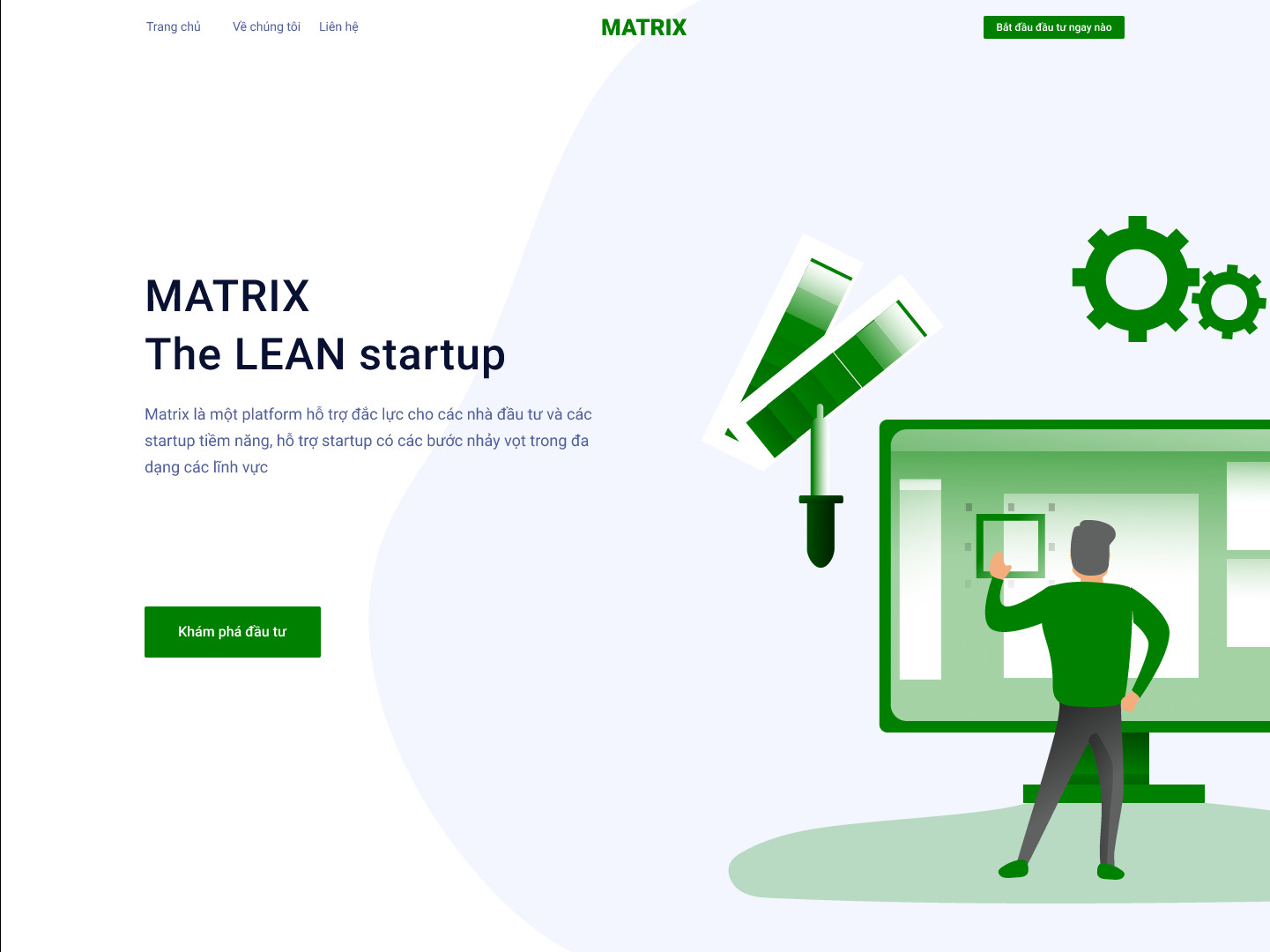
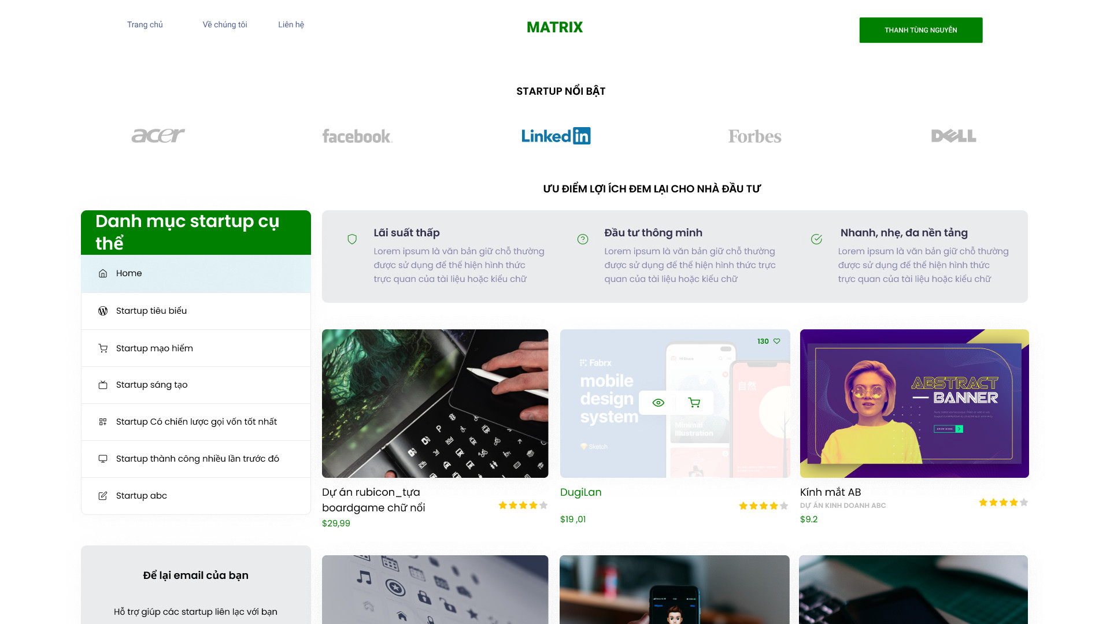
11. PRODUCT IMAGES (Web)

Slide 22
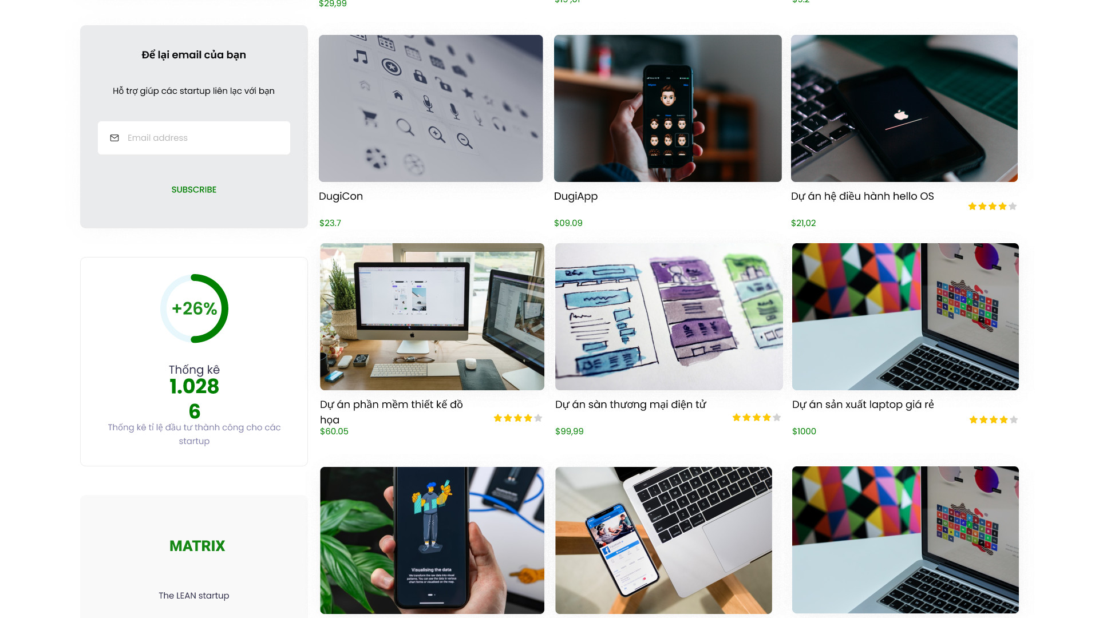
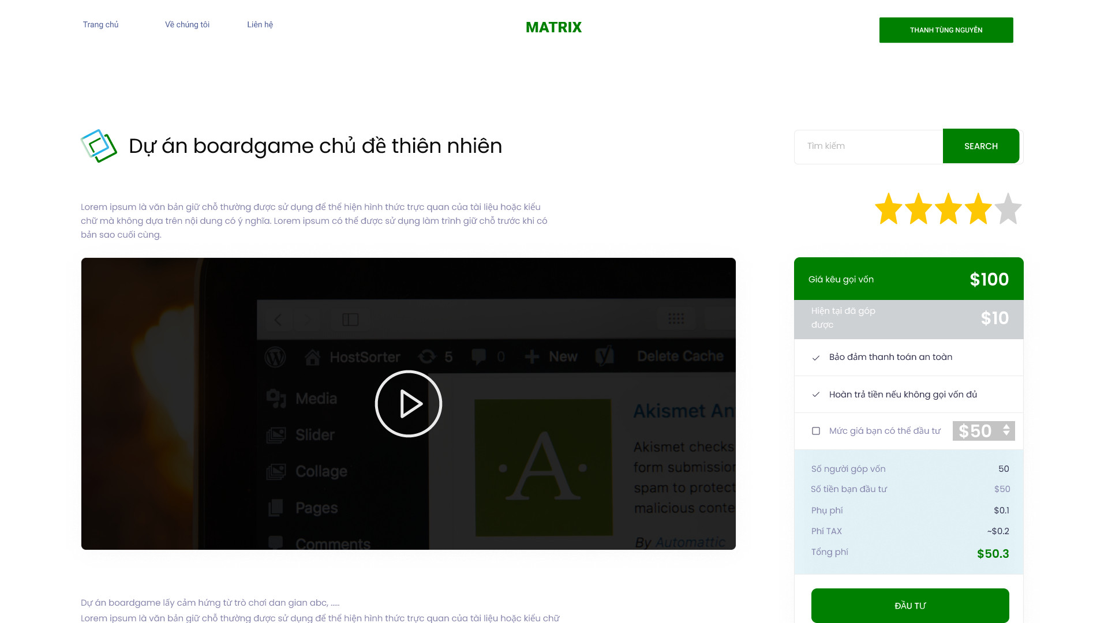
11. PRODUCT IMAGES (Web)

Slide 23
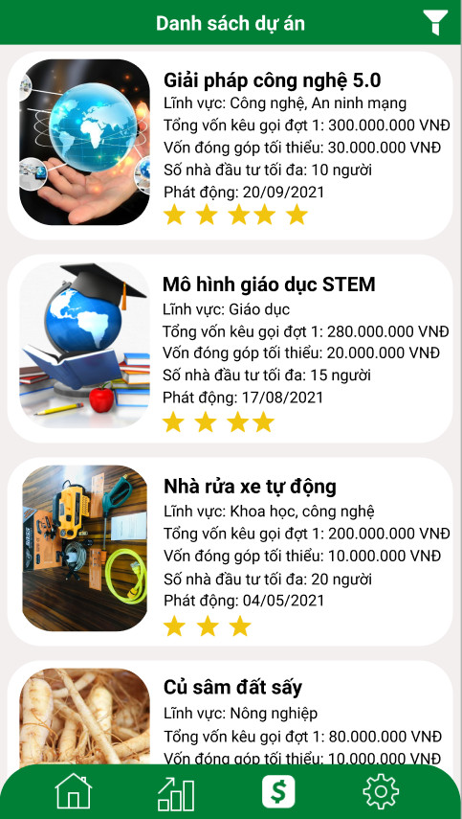
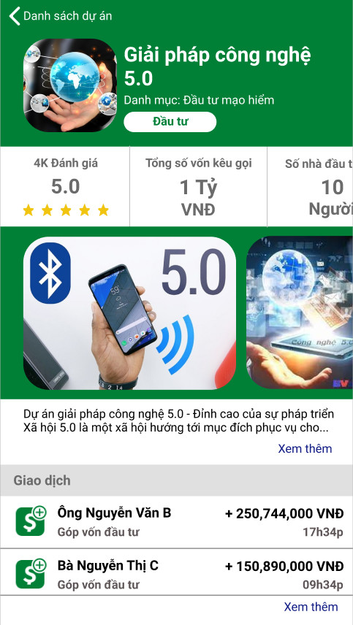
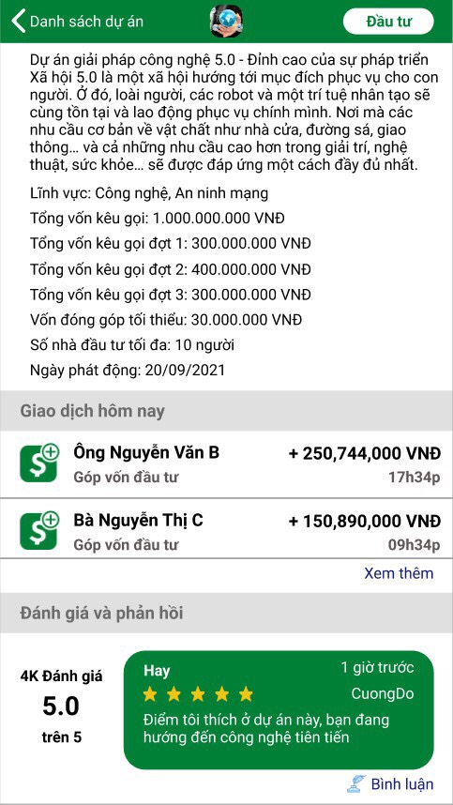
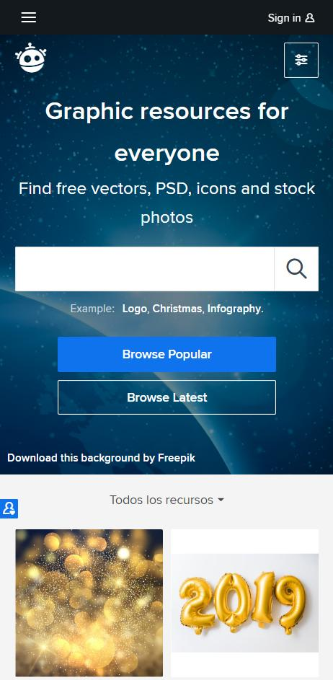
11. PRODUCT IMAGES (App demo)
Notes:
Thêm hình ảnh trước slides này (log in, tài khoản) hoặc video sau khi kết thúc trình bày

Slide 24
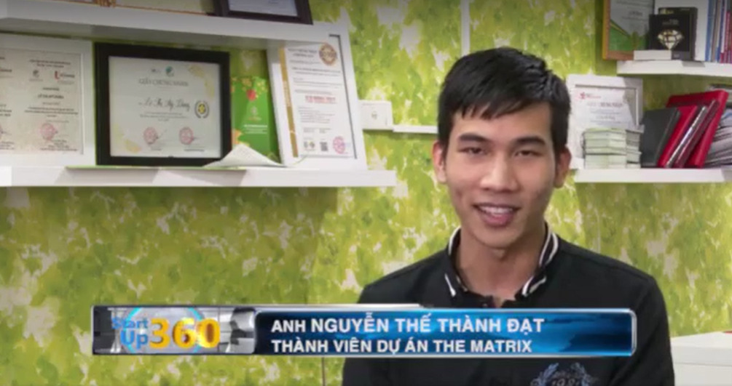
12. OUR ACHIEVEMENTS
Go to start-up 360 TV channel
Round 1: Top 10 most voted projects through the online public voting system
Round 2: Top 5 BEST PROJECTS OF TECHFEST STK VILLAGE.
Round 3: Top 3 best projects (out of 50 projects) go straight to the final round of the National Techfest Competition 2021

Slide 25
CONTACT INFORMATION
Full name: Pham Huy Hung
Email: cuongdo@tlu.edu.vn
Phone number: 076.622.3870 -091.581.1888
Address: 175 Tay Son Str, Dong Da, Hanoi
THANK YOU

Slide 26
THANK YOU FOR LISTENING!

